Slide 1

CS 188: Artificial Intelligence
Inference in Markov Models
Instructors: Stuart Russell and Dawn Song
University of California, Berkeley
Notes:
Please retain proper attribution, including the reference to ai.berkeley.edu. Thanks!
Note: pretty short lecture, good one to present mini-contest results or anything else not exactly lecture.

Slide 2
HMM as probability model
Joint distribution for Markov model: P(X₀,…, X_{T}) = P(X₀) ∏_{t=1:T} P(X_{t} | X_{t-1})
Joint distribution for hidden Markov model: P(X₀,X₁,…, X_{T},E_{T}) = P(X₀) ∏_{t=1:T} P(X_{t} | X_{t-1}) P(E_{t} | X_{t})
Future states are independent of the past given the present
Current evidence is independent of everything else given the current state
X₀
X₁
X₂
X₃
X₅
Useful notation:
X_{a:b} = X_{a} , X_{a+1}, …, X_{b}
E₁
E₂
E₃
E₅
Notes:
Add conditional independence consequences here

Slide 3
Inference tasks
Filtering: P(X_{t}|e_{1:t})
belief state—input to the decision process of a rational agent
Prediction: P(X_{t+k}|e_{1:t}) for k > 0
evaluation of possible action sequences; like filtering without the evidence
Smoothing: P(X_{k}|e_{1:t}) for 0 ≤ k < t
better estimate of past states, essential for learning
Most likely explanation: arg max_{x1:t} P(x_{1:t} | e_{1:t})
speech recognition, decoding with a noisy channel

Slide 4
Other HMM Queries
Filtering: P(X_{t}|e_{1:t})
Prediction: P(X_{t+k}|e_{1:t})
X₁
X₂
X₃
X₄
X₁
X₂
X₃
X₄
e₁
e₂
e₃
e₄
e₁
e₂
e₃
Smoothing: P(X_{k}|e_{1:t}), k<t
Explanation: P(X_{1:t}|e_{1:t})
X₁
X₂
X₃
X₄
X₁
X₂
X₃
X₄
e₁
e₂
e₃
e₄
e₁
e₂
e₃
e₄

Slide 5
Filtering / Monitoring
Filtering, or monitoring, or state estimation, is the task of maintaining the distribution f_{1:t} = P(X_{t}|e_{1:t}) over time
We start with f₀ in an initial setting, usually uniform
Filtering is a fundamental task in engineering and science
The Kalman filter (continuous variables, linear dynamics, Gaussian noise) was invented in 1960 and used for trajectory estimation in the Apollo program; core ideas used by Gauss for planetary observations
Notes:
Dan has some demo for this

Slide 6
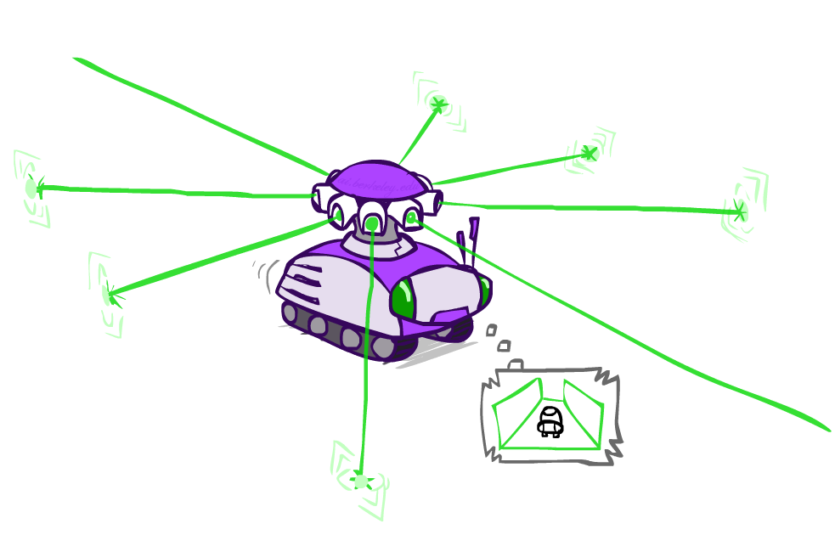
Example: Robot Localization
Example from Michael Pfeiffer
Prob
0
1
t=0
Sensor model: four bits for wall/no-wall in each direction, never more than 1 mistake
Transition model: action may fail with small prob.

Slide 7
Example: Robot Localization
Prob
0
1
t=1
Lighter grey: was possible to get the reading,
but less likely (required 1 mistake)

Slide 8
Example: Robot Localization
Prob
0
1
t=2

Slide 9
Example: Robot Localization
Prob
0
1
t=3

Slide 10
Example: Robot Localization
Prob
0
1
t=4

Slide 11
Example: Robot Localization
Prob
0
1
t=5

Slide 12
Filtering algorithm
Aim: devise a recursive filtering algorithm of the form
P(X_{t+1}|e_{1:t+1}) = g(e_{t+1}, P(X_{t}|e_{1:t}) )
P(X_{t+1}|e_{1:t+1}) =

Slide 13
Filtering algorithm
Aim: devise a recursive filtering algorithm of the form
P(X_{t+1}|e_{1:t+1}) = g(e_{t+1}, P(X_{t}|e_{1:t}) )
P(X_{t+1}|e_{1:t+1}) = P(X_{t+1}|e_{1:t}, e_{t+1})
= α P(e_{t+1}|X_{t+1}, e_{1:t}) P(X_{t+1}| e_{1:t})
= α P(e_{t+1}|X_{t+1}) P(X_{t+1}| e_{1:t})
= α P(e_{t+1}|X_{t+1}) ∑_{xt} P(x_{t} | e_{1:t}) P(X_{t+1}| x_{t}, e_{1:t})
= α P(e_{t+1}|X_{t+1}) ∑_{xt} P(x_{t} | e_{1:t}) P(X_{t+1}| x_{t})
Apply Bayes’ rule
Apply conditional independence
Condition on X_{t}
Apply conditional
independence
Normalize
Update
Predict

Slide 14


Filtering algorithm
P(X_{t+1}|e_{1:t+1}) = α P(e_{t+1}|X_{t+1}) ∑_{xt} P(x_{t} | e_{1:t}) P(X_{t+1}| x_{t})
f_{1:t+1} = Forward(f_{1:t} , e_{t+1})
Cost per time step: O(|X|²) where |X| is the number of states
Time and space costs are constant, independent of t
O(|X|²) is infeasible for models with many state variables
We get to invent really cool approximate filtering algorithms
Normalize
Update
Predict

Slide 15
And the same thing in linear algebra
Transition matrix T, observation matrix O_{t}
Observation matrix has state likelihoods for E_{t} along diagonal
E.g., for U₁ = true, O₁ = ( )
Filtering algorithm becomes
f_{1:t+1} = α O_{t+1}T^{T} f_{1:t}
0.2 0
0 0.9
X_{t-1} | P(X_{t}|X_{t-1})
 | sun | rain
sun | 0.9 | 0.1
rain | 0.3 | 0.7
W_{t} | P(U_{t}|W_{t})
 | true | false
sun | 0.2 | 0.8
rain | 0.9 | 0.1

Slide 16

Example: Weather HMM
0.6
0.4
0.45
0.55
predict
predict
update
update
W_{t-1} | P(W_{t}|W_{t-1})
 | sun | rain
sun | 0.9 | 0.1
rain | 0.3 | 0.7
f(sun) = 0.5
f(rain) = 0.5
f(sun) = 0.25
f(rain) = 0.75
f(sun) = 0.154
f(rain) = 0.846
Weather₀
Weather₁
Weather₂
W_{t} | P(U_{t}|W_{t})
 | true | false
sun | 0.2 | 0.8
rain | 0.9 | 0.1
P(W₀)
sun | rain
0.5 | 0.5
Umbrella₁
Umbrella₂
Notes:
Fix numbers

Slide 17
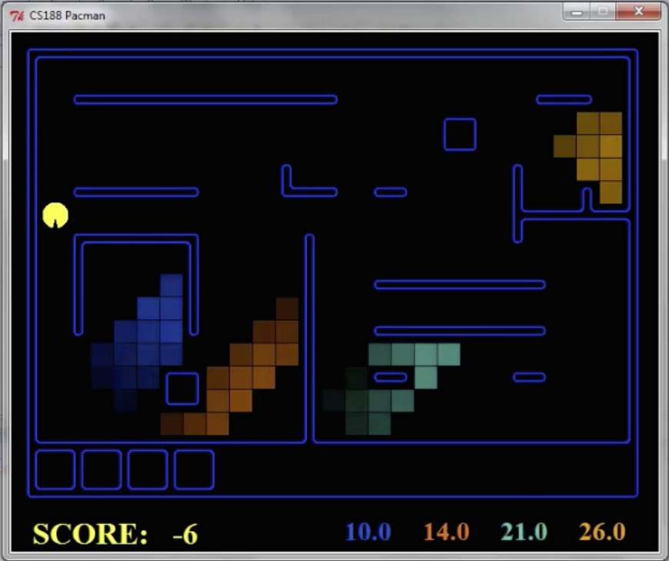
Pacman – Hunting Invisible Ghosts with Sonar
[Demo: Pacman – Sonar – No Beliefs(L14D1)]

Slide 18

Video of Demo Pacman – Sonar

Slide 19

Most Likely Explanation

Slide 20
Inference tasks
Filtering: P(X_{t}|e_{1:t})
belief state—input to the decision process of a rational agent
Prediction: P(X_{t+k}|e_{1:t}) for k > 0
evaluation of possible action sequences; like filtering without the evidence
Smoothing: P(X_{k}|e_{1:t}) for 0 ≤ k < t
better estimate of past states, essential for learning
Most likely explanation: arg max_{x1:t} P(x_{1:t} | e_{1:t})
speech recognition, decoding with a noisy channel

Slide 21
Most likely explanation = most probable path
arg max_{x1:t} P(x_{1:t} | e_{1:t})
= arg max_{x1:t} α P(x_{1:t} , e_{1:t})
= arg max_{x1:t} P(x_{1:t} , e_{1:t})
= arg max_{x1:t} P(x₀) ∏_{t} P(x_{t} | x_{t-1}) P(e_{t} | x_{t})
State trellis: graph of states and transitions over time
Each arc represents some transition x_{t-1} → x_{t}
Each arc has weight P(x_{t} | x_{t-1}) P(e_{t} | x_{t}) (arcs to initial states have weight P(x₀) )
The product of weights on a path is proportional to that state sequence’s probability
Forward algorithm computes sums of paths, Viterbi algorithm computes best paths
sun
sun
sun
sun
rain
rain
rain
rain
X₀ X₁ … X_{T}

Slide 22
Forward / Viterbi algorithms
sun
sun
sun
sun
rain
rain
rain
rain
X₀ X₁ … X_{T}
Forward Algorithm (sum)
For each state at time t, keep track of the total probability of all paths to it
Viterbi Algorithm (max)
For each state at time t, keep track of the maximum probability of any path to it
f_{1:t+1} = Forward(f_{1:t} , e_{t+1})
= α P(e_{t+1}|X_{t+1}) ∑_{xt} P(X_{t+1}| x_{t}) f_{1:t}
m_{1:t+1} = Viterbi(m_{1:t} , e_{t+1})
= P(e_{t+1}|X_{t+1}) max_{xt} P(X_{t+1}| x_{t}) m_{1:t}

Slide 23
Viterbi algorithm contd.
W_{t-1} | P(W_{t}|W_{t-1})
 | sun | rain
sun | 0.9 | 0.1
rain | 0.3 | 0.7
0.5
sun
0.18
0.72
0.18
0.5
sun
sun
sun
0.09
0.076
0.0136080
0.09
0.01
0.09
0.06
0.24
0.06
0.5
rain
rain
rain
rain
0.5
0.315
0.022
0.0138495
0.63
0.07
0.63
W_{t} | P(U_{t}|W_{t})
 | true | false
sun | 0.2 | 0.8
rain | 0.9 | 0.1
X₀ X₁ X₂ X_{T}
U₁=true U₂=false U₃=true
Time complexity?
O(|X|² T)
Space complexity?
O(|X| T)
Number of paths?
O(|X|^{T})

Slide 24
Viterbi in negative log space
W_{t-1} | P(W_{t}|W_{t-1})
 | sun | rain
sun | 0.9 | 0.1
rain | 0.3 | 0.7
1.0
sun
2.47
sun
0.72
sun
2.47
sun
S
3.47
6.64
3.47
4.06
2.06
4.06
1.0
rain
rain
rain
rain
0.67
3.84
0.67
W_{t} | P(U_{t}|W_{t})
 | true | false
sun | 0.2 | 0.8
rain | 0.9 | 0.1
G
argmax of product of probabilities
= argmin of sum of negative log probabilities
= minimum-cost path
Viterbi is essentially breadth-first graph search
What about A*?

